Slide 1
Chapter 6: Process Synchronization
Apr, 2024

Slide 2
Chapter 6: Process Synchronization
Background
The Critical-Section Problem
Software Solution
Synchronization Hardware
Mutex Locks

Slide 3
Objectives
To introduce the critical-section problem, whose solutions can be used to ensure the consistency of shared data
To present both software and hardware solutions of the critical-section problem
To explore several tools that are used to solve process synchronization problems

Slide 4
Background
Processes can execute concurrently
May be interrupted at any time, partially completing execution
Concurrent（并发，不是parallelism并行） access to shared data may result in data inconsistency（不一致）
Maintaining data consistency requires mechanisms to ensure the orderly execution of cooperating processes

Slide 5
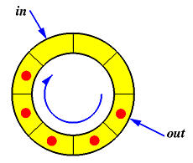
Producer
while (true) { /* produce an item in next produced */
while (counter == BUFFER_SIZE) ;
/* do nothing */
buffer[in] = next produced;
in = (in + 1) % BUFFER SIZE;
counter++;
}
counter

Slide 6
Consumer
while (true) {
while (counter == 0)
; /* do nothing */
next consumed = buffer[out];
out = (out + 1) % BUFFER_SIZE;
counter--;
/* consume the item in next consumed */
}

Slide 7
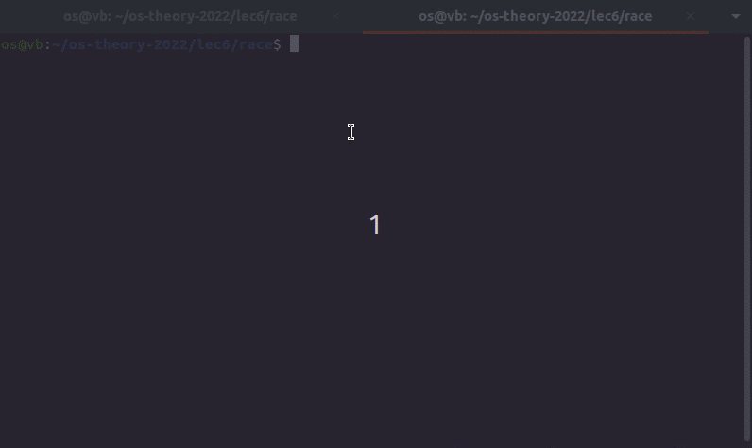
Result

Slide 8

Result

Slide 9
Result
counter++ could be implemented as register1 = counter register1 = register1 + 1 counter = register1
counter-- could be implemented as register2 = counter register2 = register2 - 1 counter = register2
Consider this execution interleaving with “count = 5” initially:
S0: producer execute register1 = counter {register1 = 5} S1: producer execute register1 = register1 + 1 {register1 = 6} S2: consumer execute register2 = counter {register2 = 5} S3: consumer execute register2 = register2 – 1 {register2 = 4} S4: producer execute counter = register1 {counter = 6 } S5: consumer execute counter = register2 {counter = 4}
Notes:
Given an example: objdump -d [filename]

Slide 10
Race condition
several processes access and manipulate the same data concurrently and the
outcome of the execution depends on the particular order in which the access takes place

Slide 11
Critical Section Problem
Consider system of n processes {p₀, p₁, … p_{n-1}}
Each process has critical section segment of code
Process may be changing common variables, updating table, writing file, etc sharing resources
When one process in critical section, no other may be in its critical section
That is, no two processes are executing in their critical sections at the same time
Critical section problem is to design protocol to solve this
Notes:
no two processes are executing in their critical sections at the same time

Slide 12
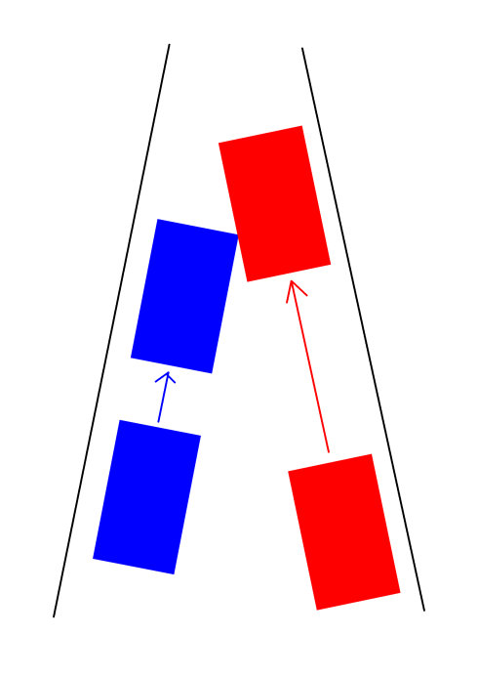
Critical Section Problem

Slide 13
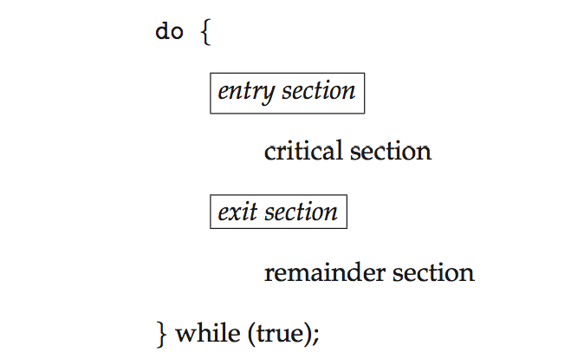
Critical Section
Each process must ask permission to enter critical section in entry section, may follow critical section with exit section, then remainder section

Slide 14
Solution Requirements for Critical-Section Problem
Mutual Exclusion - If process P_{i} is executing in its critical section, then no other processes can be executing in their critical section
Progress - If no process is executing in its critical section and there exist some processes that wish to enter their critical section, then only those processes that are not executing in their remainder sections can participate in deciding which will enter its critical section next, and this selection cannot be postponed indefinitely
Bounded Waiting - A bound must exist on the number of times that other processes are allowed to enter their critical sections after a process has made a request to enter its critical section and before that request is granted
Notes:
第一点：互斥
第二点：空闲让进（没有进程在临界区）
第三点：fairness有限等待（一个进程不能频繁的进入临界区）

Slide 15
Solution 1
flag = false;
//P0
while (flag == true); //do nothing
flag = true;
//critical section;
flag = false;
//remainder section;
//P1
while (flag == true); //do nothing
flag = true;
//critical section;
flag = false;
//remainder section;
What’s the problem?
Notes:
漏洞：可以让多个进程都执行到临界区前
Mutual exclusion violated

Slide 16
Solution 2
turn = 0;
//P0
while (turn == 1); //do nothing
//critical section;
turn = 1;
//remainder section;
//P1
while (turn == 0); //do nothing
//critical section;
turn = 0;
//remainder section;
remainder
What’s the problem?
Notes:
Take turns
Can have mutual exclusion but may not make progress
这种算法能够保证互斥性，但它要求P0,P1在临界区中的执行是严格交替的。如果turn=1，且P0要进入临界区，那么尽管P1可能在其剩余区内，P0并不能进入。
忙等待（Busy Waiting）：
进程在等待进入临界区时会不断检查 turn 的值，这会浪费 CPU 时间。
忙等待会导致资源利用效率低下，特别是在单处理器系统中。
缺乏公平性：
这种方法不能确保进程公平地获得临界区的访问权限。某个进程可能会长时间占用临界区，导致另一个进程饥饿。
仅适用于两个进程：
这种机制只适用于两个进程的同步，对于多于两个进程的情况需要更复杂的同步机制

Slide 17
Solution 3
//P0
flag[0] = true;
while (flag[1] == true); //do nothing
//critical section;
flag[0] = false;
//remainder section;
//P1
flag[1] = true;
while (flag[0] == true); //do nothing
//critical section;
flag[1] = false;
//remainder section;
What’s the problem?
Notes:
Have mutual exclusion but may not make progress (deadlock)
如果两个进程同时设置flag[i] = true，那么会死锁

Slide 18
Peterson’s Solution
Good algorithmic description of solving the problem
Two process solution
The two processes share two variables:
int turn;
Boolean flag[2]
The variable turn indicates whose turn it is to enter the critical section
The flag array is used to indicate if a process is ready to enter the critical section. flag[i] = true implies that process P_{i} is ready!
Notes:
Flag表示i是否希望进入临界区
Turn表示轮到谁进入临界区

Slide 19
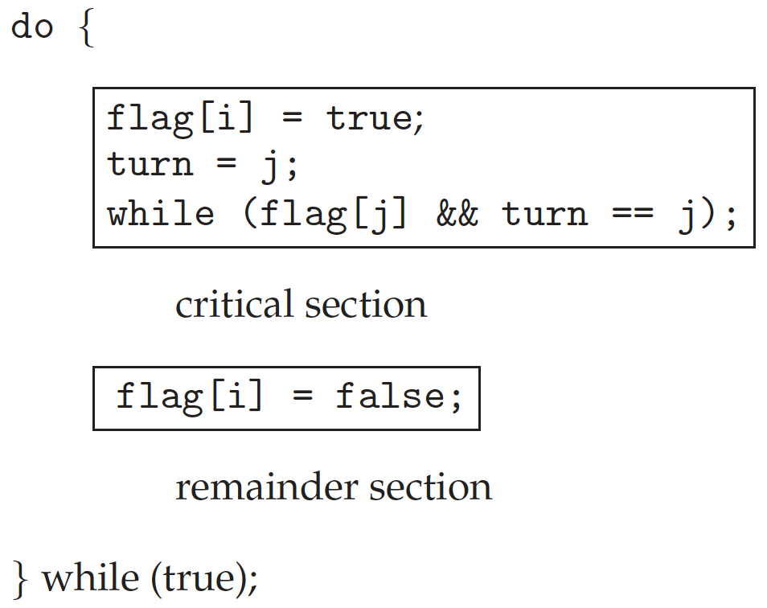
Algorithm for Process P_{i}
Notes:
先表明自己（i）想进入临界区，
然后询问j（turn=j），
如果j表明自己希望进入临界区且也轮到了j，则i等待，让j进入；
否则i进入

Slide 20
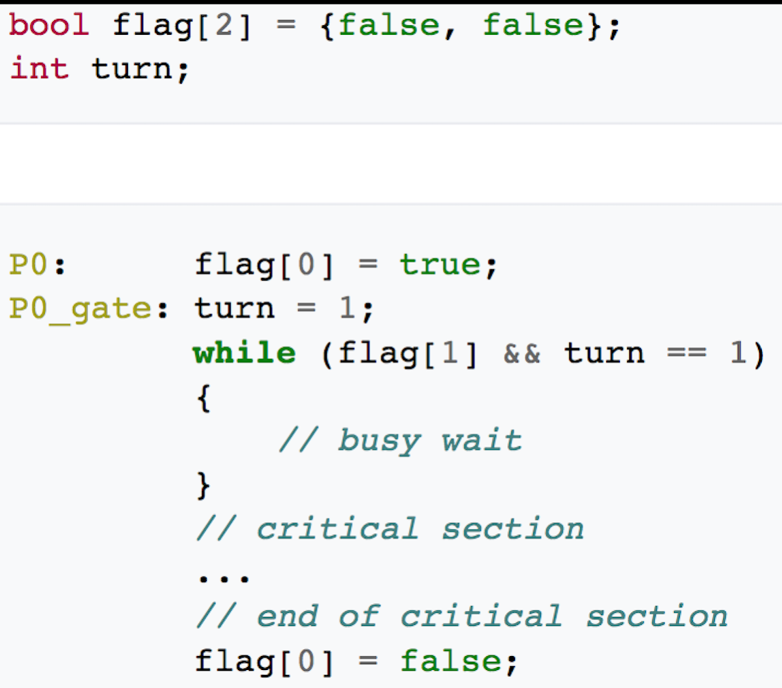
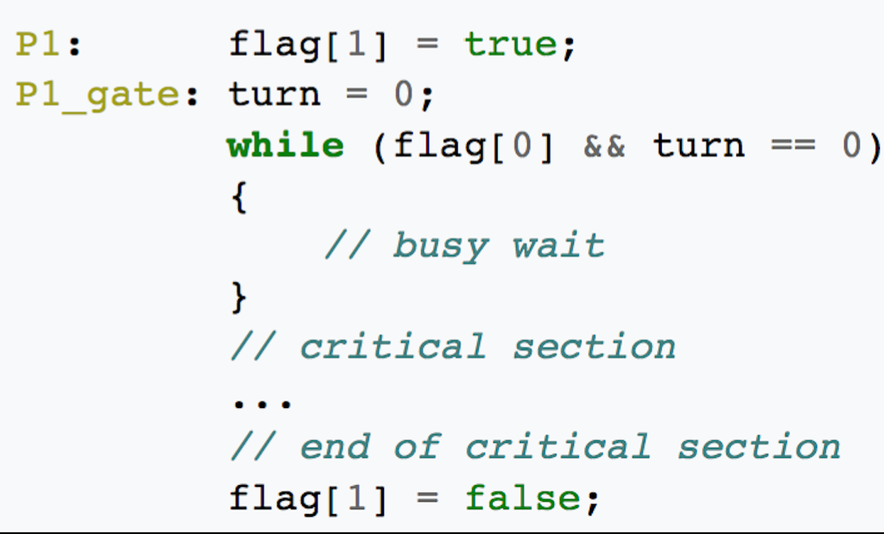
Correctness
Provable that
Mutual exclusion is preserved
Progress requirement is satisfied
Bounded-waiting requirement is met
Notes:
如果都表示自己想进入，都询问对方，turn是一定只有一个选择的，所以只会有一个进程进入critic section

Slide 21
Synchronization Hardware
Many systems provide hardware support for critical section code
All solutions below based on idea of locking
Protecting critical regions via locks
Uniprocessors – could disable interrupts
Currently running code would execute without preemption
Generally too inefficient on multiprocessor systems
Operating systems using this not broadly scalable
Modern machines provide special atomic hardware instructions
Atomic = non-interruptible
Either test memory word and set value
Or swap contents of two memory words
What is atomic?
Notes:
All or none

Slide 22
Solution 1可以改进！
flag = false;
//P0
while (flag == true); //do nothing
flag = true;
//critical section;
flag = false;
//remainder section;
//P1
while (flag == true); //do nothing
flag = true;
//critical section;
flag = false;
//remainder section;
不是atomic instruction导致的非互斥
Notes:
Mutual exclusion violated（违反）
不是atomic instruction导致的非互斥

Slide 23
test_and_set Instruction
Definition:
boolean test_and_set(boolean *lock)
{
boolean test_lock = *lock;
*lock = true; //set
return test_lock; //test
}
boolean lock = false;

Slide 24
Mutex Solution using test_and_set()
Shared Boolean variable lock, initialized to false (unlocked)
Solution:
do
{ while(test_and_set(&lock)); /* do nothing */
/* critical section */
lock = false;
/* remainder section */
} while (true);

Slide 25
compare_and_swap Instruction
Definition:
int compare_and_swap(int *lock, int expected, int new)
{
int curr_lock = *lock;
if (*lock == expected) //expected = 0
*lock = new; //new = 1
return curr_lock;
}
int lock = 0; //unclocked
Notes:
比较锁的当前值是否等于预期值0，
如果相等，代表没有被锁定，将锁设置为新值1，代表我占了这个锁。然后返回修改前的值0
如果不等，那说明有别的进程进入临界区，肯定返回1停在while了反正

Slide 26
Mutex Solution using compare_and_swap
Shared integer variable lock initialized to 0; //unlocked
Solution:
do
{ while(compare_and_swap(&lock, 0, 1) == 1); //do nothing
/* critical section */
lock = 0;
/* remainder section */
} while(true);

Slide 27
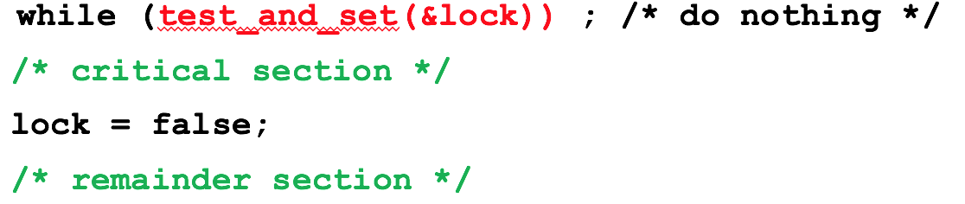
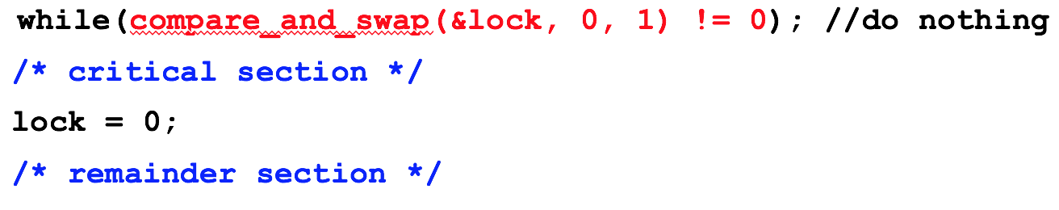
Atomic Instruction Solution
Notes:
https://www.zhihu.com/question/472526118/answer/2008610919
x86的lock#指令前缀（prefix）主要解决原子性（atomicity）的问题，同时隐含了内存屏障（memory barrier）。相当于这条原子指令执行结束后，写到内存地址的内容是对其他核心都可见的。现代硬件一般是通过lock cache来实现的（主要是通过cache coherence逻辑来实现），一些特殊情况还是需要lock bus，但是性能会差很多。传统的CPU也是通过lock bus来实现原子指令的。关于lock#前缀的详细说明还是要参考intel的手册。还有一个和atomicity相关的概念是transaction memory，有兴趣可以看一下。
JAVA的volatile本身只需要保证memory order，而不需要原子性，所以一般只需要通过（内存屏障）memory barrier指令（linux里面抽象为smp_rmb()，smp_wmb()，smp_mb()）来实现。
lock#前缀因为隐含memory barrier所以也是可以实现volatile的功能的。memoy order是memory consistency解决的问题，这里和内存一致性（memory coherence）是不同的概念，memory consistency和CPU里面的out-of-order execution，write buffer，invalidate queue等相关。

Slide 28
Mutex Locks
Previous solutions are complicated and generally inaccessible to application programmers
OS designers build software tools to solve critical section problem
Simplest is mutex lock
Product critical regions with it by first acquire() a lock then release() it
Boolean variable indicating if lock is available or not

Slide 29
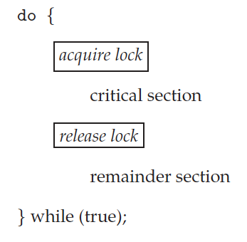

Solution to Critical-section Problem Using Locks
test_and_set
compare_and_swap
demo

Slide 30
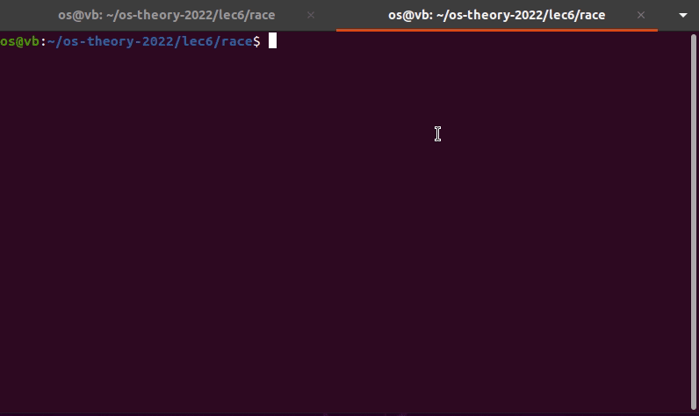
Mutex Demo code
Notes:
看实验6

Slide 31
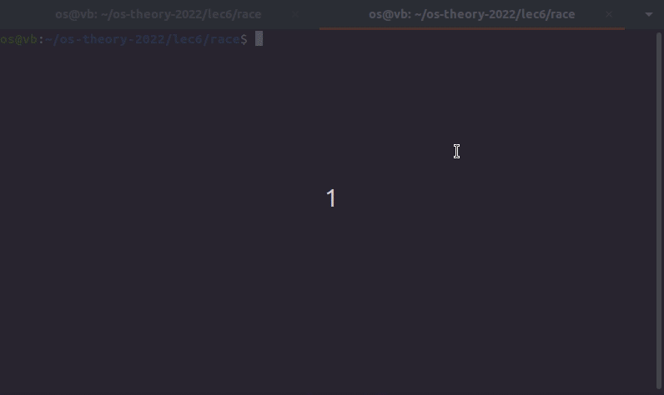
Mutex Demo result

Slide 32
Mutex Locks
Calls to acquire() and release() must be atomic
Usually implemented via hardware atomic instructions
But this solution requires busy waiting
This lock therefore called a spinlock

Slide 33
Limitations of Mutex
Busy waiting
Wait queue

Slide 34
The End

Slide 35
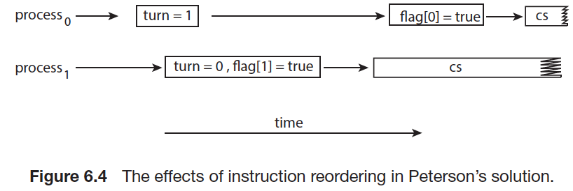
Restrictions of Peterson’s: Reorder
Two process
Software solution

Slide 36
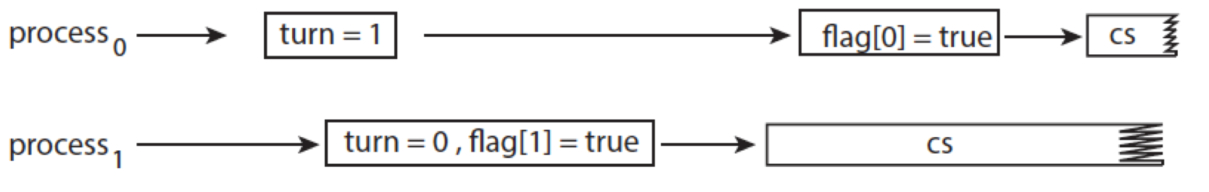
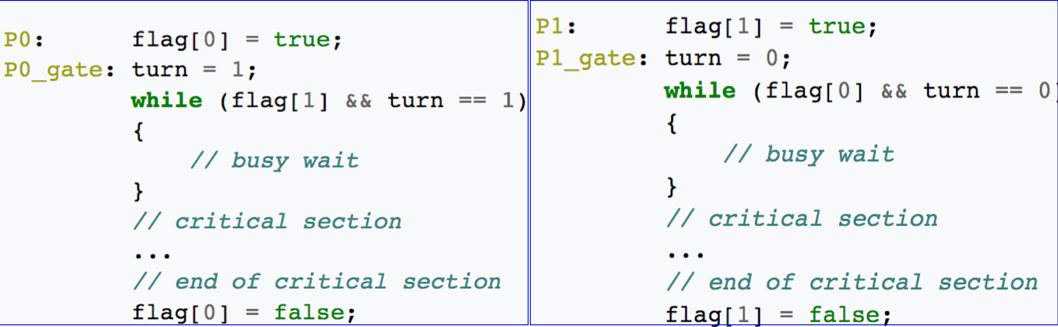
Restrictions of Peterson’s: Reorder
4
1
5
2
6
3

Slide 37
Mutual Exclusion
while True:
while True:
Notes:
如果P1首先通过测试进入了临界区，那么据P1判断时间轴上的最新值是 （flag[0]==false || turn==1）&& flag[1]==1 （＊）
此时，P0做while测试，能否通过呢？
首先，flag[1]的值在时间轴上不可能被改为1，因为只有P1能改，而P1没有退出临界区；
其次，既然P0在做while测试，则据P0判断时间轴上的最新值是flag[0]=true && turn==1; 据此和（＊）可断言
turn在时间轴上的最新值为1。且turn==1在P1退出临界区前一直保持。
所以P0的测试通不过。实现互斥

Slide 38
Process
while True:
while True:
Notes:
如果某时刻两个进程均不在临界区。此时P0首先进行了测试，则P1的情况分为：
P1在退出区或剩余区，则flag[1]==false, P0直接进入
P1在进入区，则turn==0, P0直接进入
（先让权者优先）

Slide 39
Bounded Waiting
while True:
while True:
Notes:
据前两页，
如果某时刻P0进行了测试，则P1的情况分为：
P1在退出区或剩余区，则flag[1]==false, P0直接进入
P1在进入区，则turn==0, P0直接进入
P1正在临界区，则P0不可能测试时通过；但是P1退出临界区时，会不会再次进入临界区呢？据1和2，一定会让给P0. 实现一定的公平性

